Slide 1
Help - I Need Books!
Tips for Title I Teachers Seeking Books + New Ideas for Student Engagement
Nerd Camp 2018

Slide 2
We’re So Pleased to Meet You!
Meg Medina, Award-winning Author at MegMedina.com Twitter - @Meg_Medina Instagram - @megmedinabooks
Alison Morris, Sr. Director of Collection Development at First Book Twitter - @AlisonLMorris Instagram - @kidlitgirl
Rochelle (“Ro”) Menendez, Librarian at Dr J C Cannaday Elementary School in Mesquite, TX Twitter - @RoMenendez14 Instagram - @romenendez14
Ashleigh Rose, 6th Grade Literacy Teacher at KIPP DC: AIM Academy in Washington, D.C. Twitter - @betweenmargins/ @projectlitAIM Instagram - @betweenmargins

Slide 3
What brought you here? What do you hope to get out of this session?

Slide 4
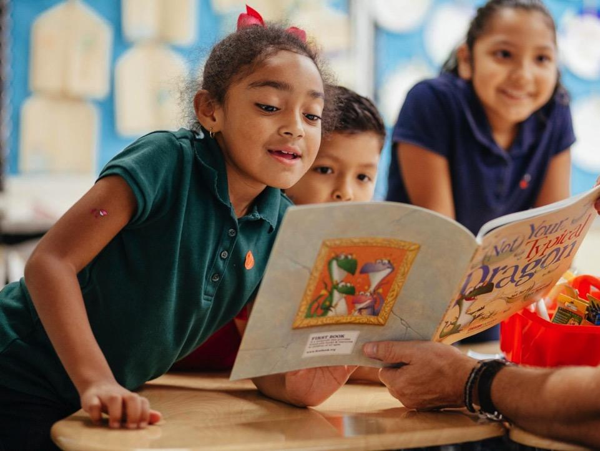
Discover
FIRST BOOK
www.firstbook.org/join
PARTNERSHIPS
‹#›

Slide 5
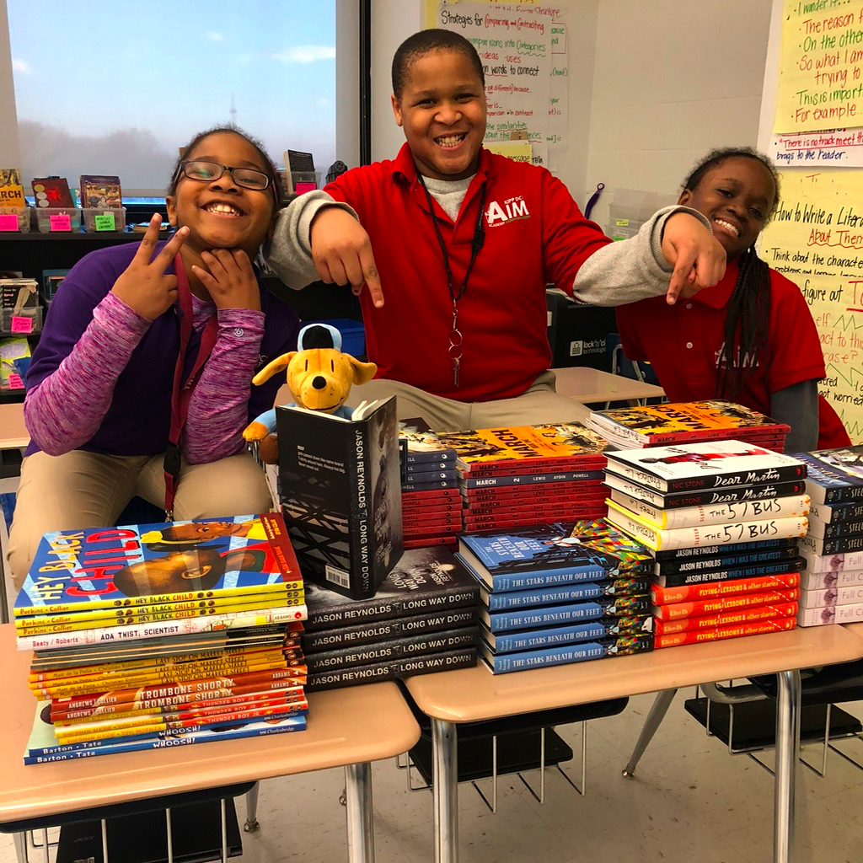
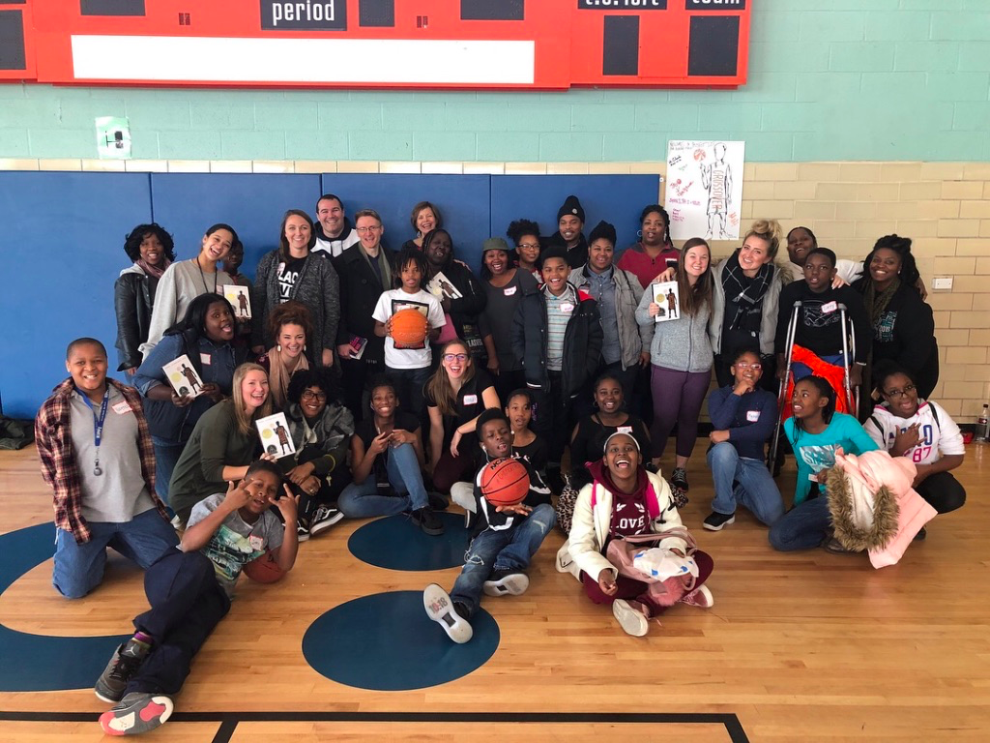
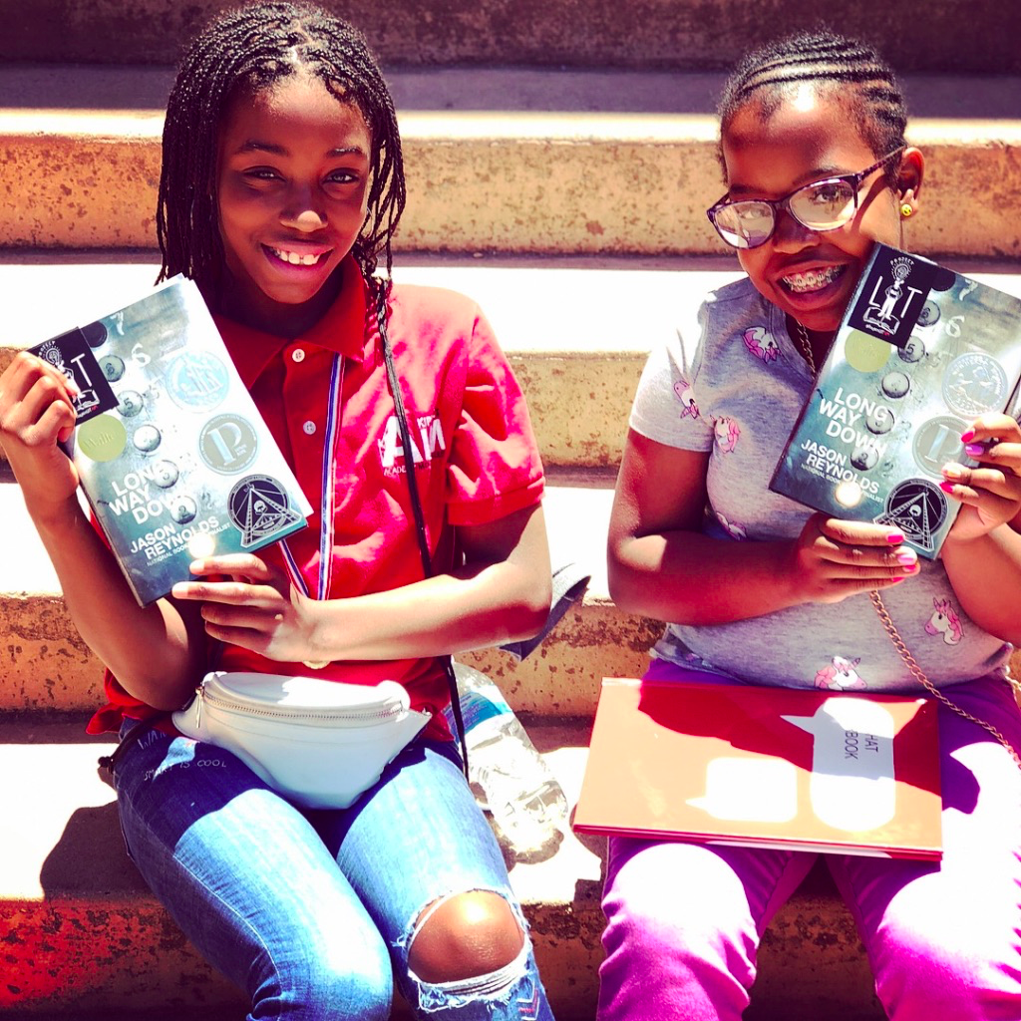
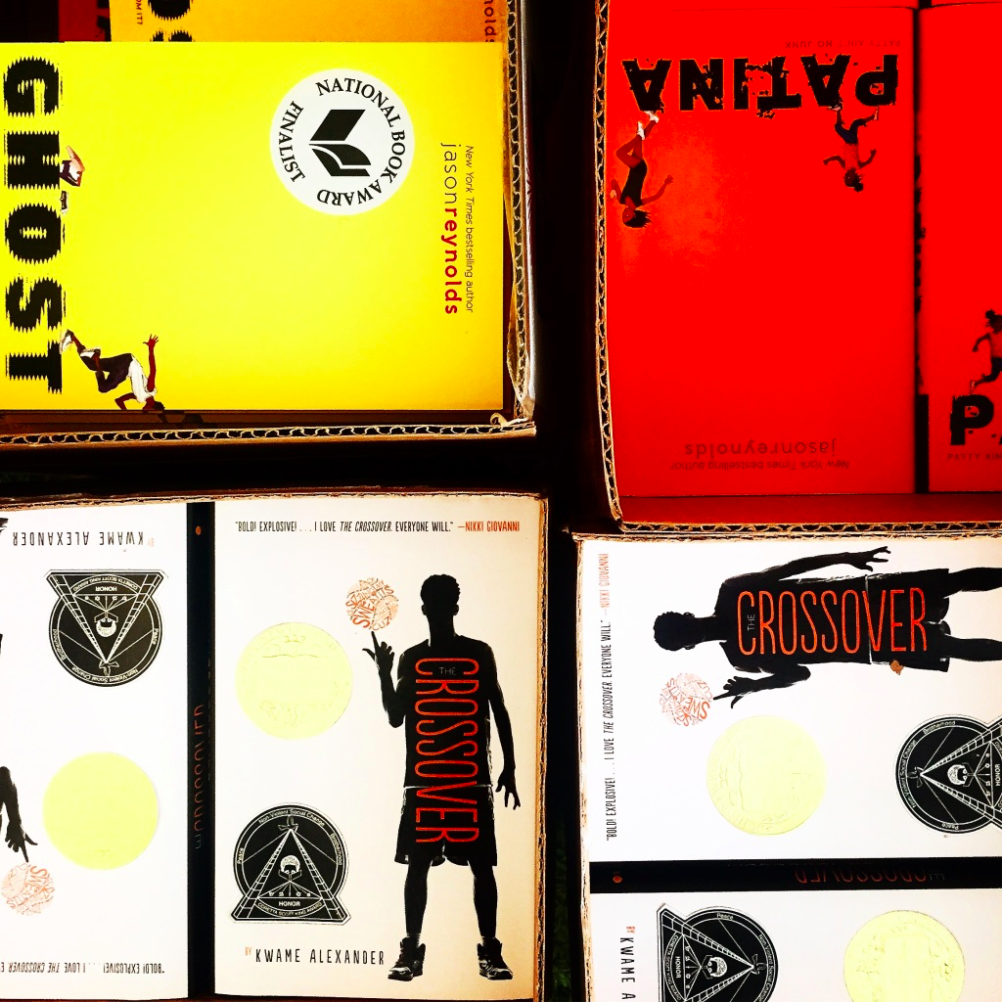
First Book is a 25 year-old nonprofit social enterprise that provides new, high quality books and educational resources to children in need.

Slide 6
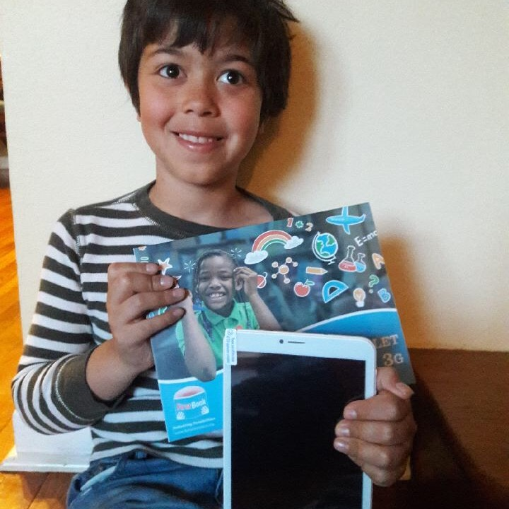
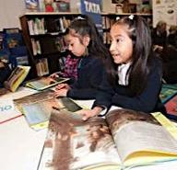
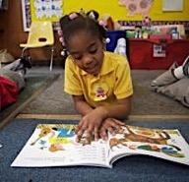
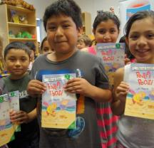
FIRST BOOK’S REACH and IMPACT
We offer a wide range of resources for educators
We’ve distributed
175 million+ books and resources
We serve 375,000+ educators working with children in need ages 0-18
We reach 5 million children annually
97% of all revenue is used directly for program impact,
providing books and educational resources for children in need.
Material included in this document is confidential and proprietary to First Book
‹#›

Slide 7
WHO CAN REGISTER WITH FIRST BOOK?
Employees or representatives of the following organizations/programs:
Title I or Title I-eligible Schools
Head Start Programs
USDA Food and Nutrition Programs
Federally Qualified Health Centers
Title VII recipients
Military family support programs
Libraries with an E-rate of 90
Programs primarily serving children with disabilities
Programs at which at least 70% of children come from low-income families.
1,000 New Members Register with First Book Each Week

Slide 8
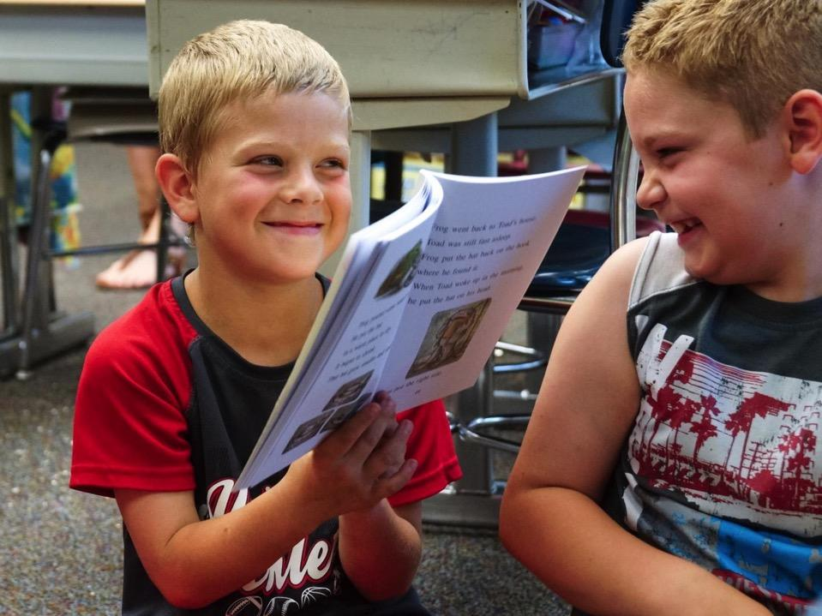
One Organization,
Two Sources for Books
‹#›

Slide 9
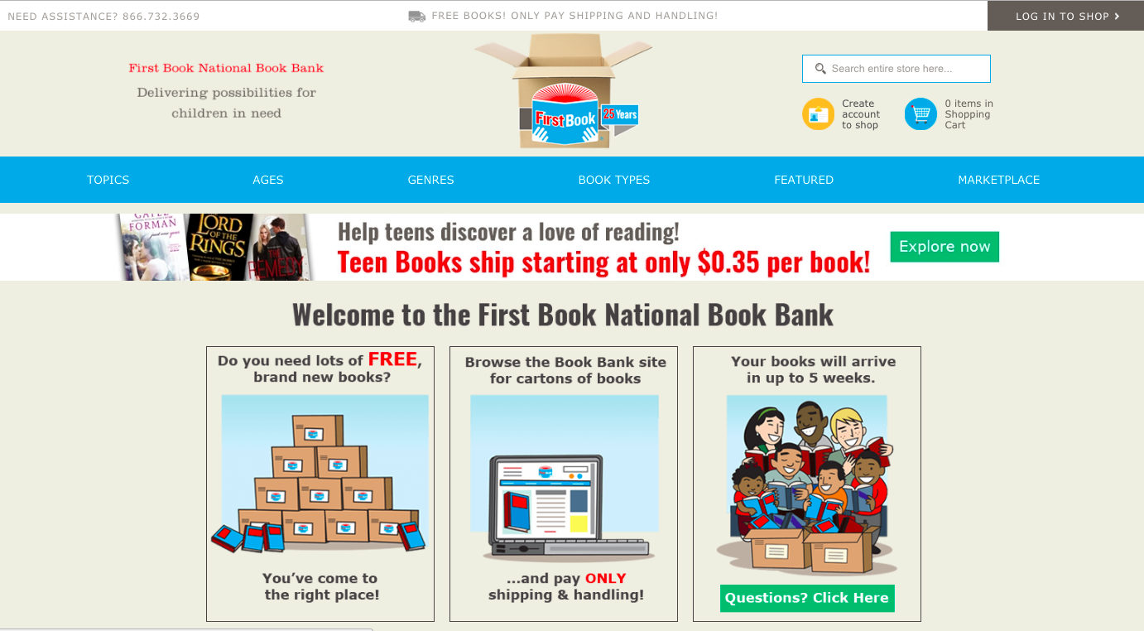
THE FIRST BOOK NATIONAL BOOK BANK - fbbookbank.org

Slide 10
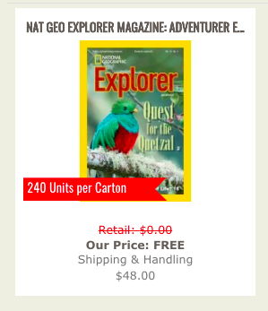
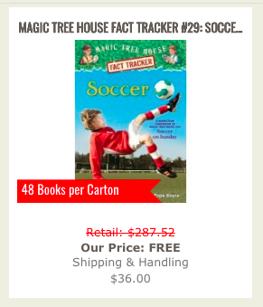
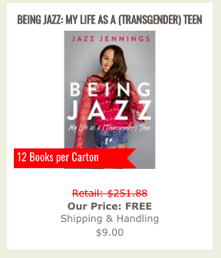
QUICK SUMMARY OF THE BOOK BANK
BRAND-NEW BOOKS DONATED BY
CHILDREN’S BOOK PUBLISHERS
TITLES AVAILABLE IN FULL CARTON QUANTITY
YOU PAY ONLY FOR SHIPPING
PERIODIC OPPORTUNITIES FOR FREE SHIPPING
‹#›

Slide 11
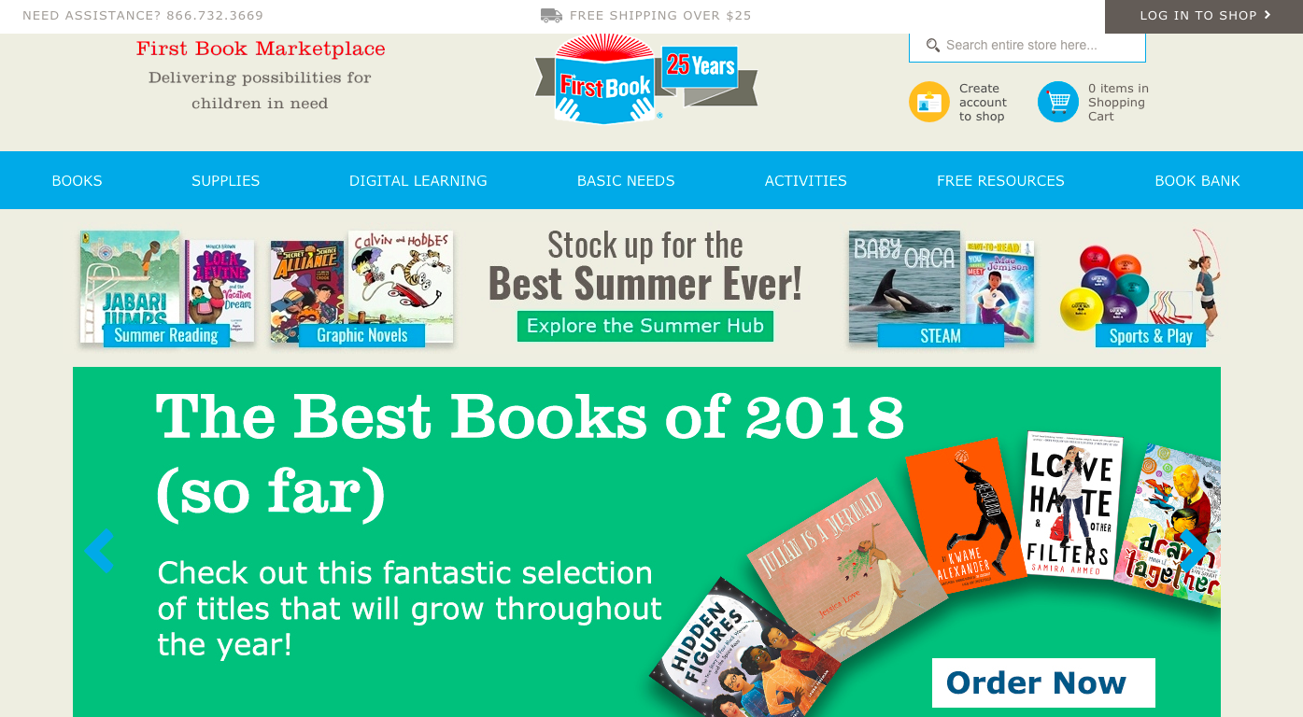
THE FIRST BOOK MARKETPLACE - FBMarketplace.org

Slide 12
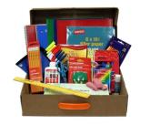
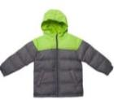
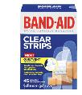
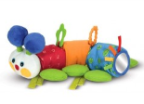
AVAILABLE ON THE FIRST BOOK MARKETPLACE
1
HIGH QUALITY BOOKS AND RESOURCES FOR AGES 0 to 18, AT PRICES TYPICALLY 50%-90% OFF RETAIL, AVAILABLE IN ANY UNIT QUANTITY
2
A ROBUST, CURATED SELECTION OF TITLES, WITH A CONSISTENT AND INTENTIONAL EMPHASIS ON DIVERSITY AND INCLUSION
3
A RANGE OF ADDITIONAL
RESOURCES BEYOND BOOKS
DIGITAL DEVICES
SCHOOL SUPPLIES
EDUCATOR RESOURCES
HANDS-ON LEARNING
BASIC NEEDS
CLOTHING
‹#›

Slide 13
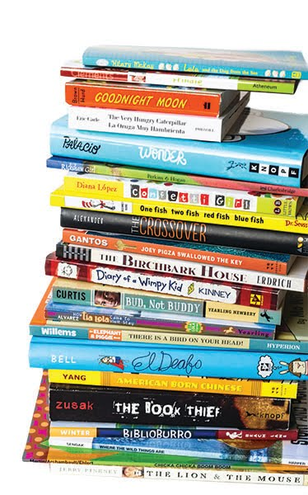
THE KINDS OF TITLES YOU’LL FIND ON THE MARKETPLACE
New Frontlist
Handpicked Backlist
Low-Cost Custom Paperback Editions
Low-Cost Remainders
Board Books
Picture Books
Beginning Readers
Chapter Books
Middle Grade Novels
Young Adult Novels
Nonfiction for All Ages
Hundreds of Titles in Spanish + Bilingual Editions (Spanish & English)
Print Books, eBooks, and eReaders
Free downloadable resources for educators and families
‹#›

Slide 14
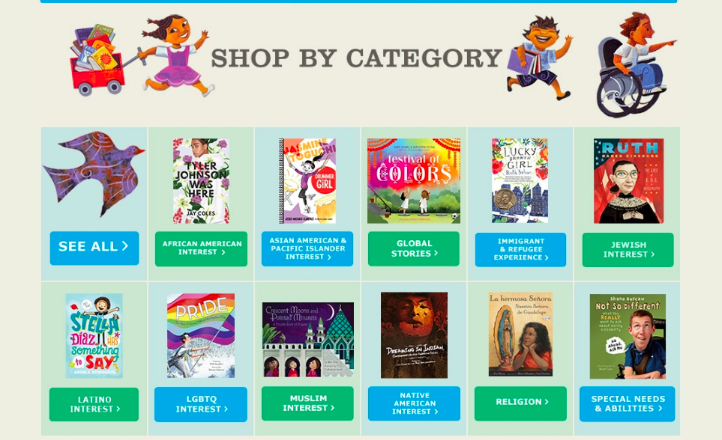
SITE-WIDE EMPHASIS ON DIVERSITY AND INCLUSION,
WITH NO PIGEON HOLES

Slide 15
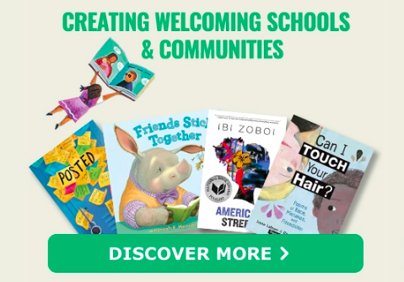
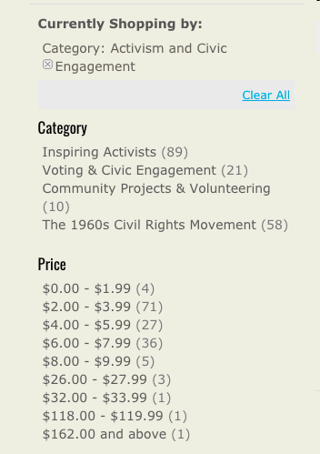
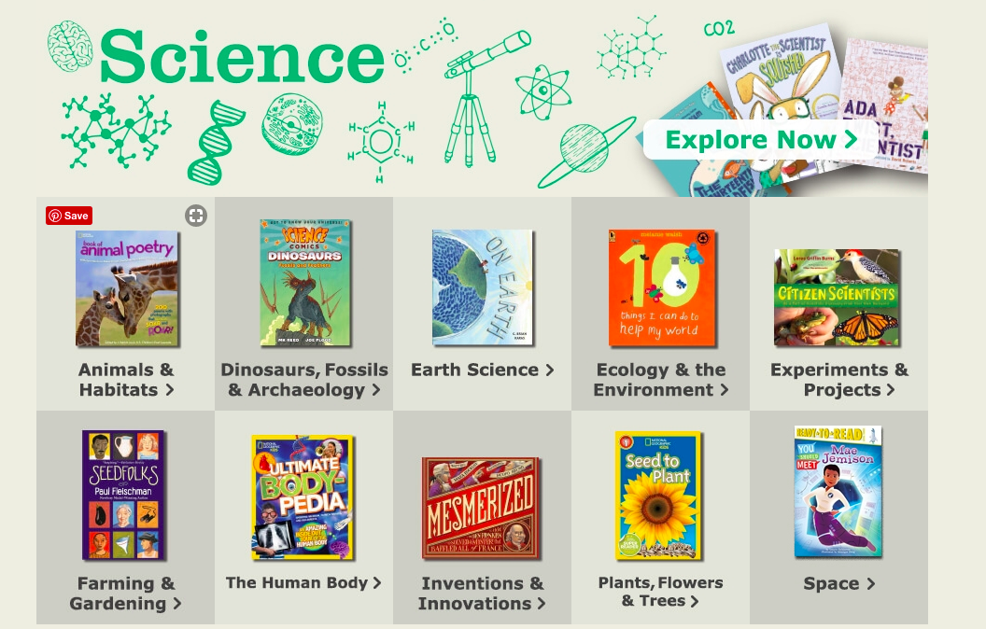
THOUGHTFUL, RELEVANT, CURATED CATEGORIES + FILTERS

Slide 16
MEMBERS ALSO HAVE ACCESS TO...
PARTNER-FUNDED OPPORTUNITIES TO RECEIVE ADDITIONAL DISCOUNTS OR SELECT FREE BOOKS
BULK PURCHASING FOR ONE-BOOK, ONE-SCHOOL PROGRAMS AND OTHER HIGH-VOLUME SPECIAL ORDERS
A FUNDRAISING PLATFORM THAT ENABLES YOU TO LAUNCH CROWD-SOURCED CAMPAIGNS
A CONTRIBUTION TO OUR MISSION: YOUR PURCHASES HELP US EXTEND OUR WORK AND PROVIDE MORE KIDS IN NEED WITH RELEVANT BOOKS AND VITAL RESOURCES

Slide 17
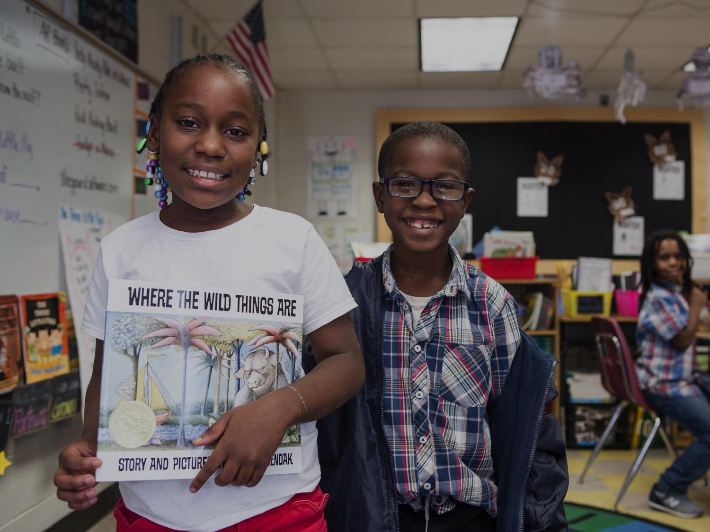
QUESTIONS?
Our Member Services team is available Monday to Friday, 8am to 6pm EST
Send an email to help@firstbook.org
Call us at (866) READ-NOW or (866) 732-3669
‹#›

Slide 18
Thank you!
FIRST BOOK REGISTRATION IS FREE AND EASY:
www.firstbook.org/join

